Slide 1
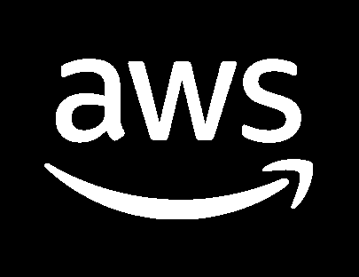

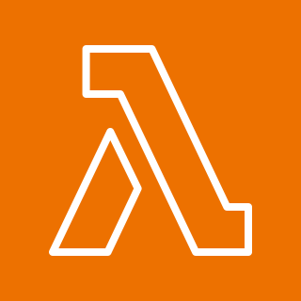









Guidance for Open Source 3D Reconstruction Toolbox for Gaussian Splats on AWS
This event-driven, serverless Reference architecture enables the generation of realistic 3D content through cutting-edge, open-source rendering techniques.
System administrator deploys solution to AWS account and region using AWS Cloud Development Kit or Terraform.
The first stack to deploy will create all of the AWS resources needed to host the solution. This includes creating S3 buckets, Lambda functions, a DynamoDB table, IAM permissions, ECR image, resource ARNs in Parameter Store, and an SNS topic is created.
Once the base stack has been deployed, the post deploy stack should be deployed. This stack will build docker container, push it to ECR, and also build and push the models used during training into S3.
1
AWS Cloud
AWS Region
1
Solution Deployment
2
Base Stack (create resources)
2
AWS
Lambda
Amazon
DynamoDB
Parameter
Store
AWS
Cloud Development Kit
Amazon
Simple Storage
Service
Amazon
Elastic Container
Registry
AWS
Identity and
Access Management (IAM)
Amazon
Simple Notification
Service
Admin
IAM user
-OR-
3
3
Post Deploy Stack (build container, push to ECR, upload model to S3)
Amazon
Simple Storage Service
Amazon
Elastic Container Registry

Slide 2









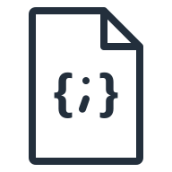

Guidance for Open Source 3D Reconstruction Toolbox for Gaussian Splats on AWS
This event-driven, serverless Reference architecture enables the generation of realistic 3D content through cutting-edge, open-source rendering techniques.
User authenticates to AWS Identity and Access Management (IAM) via AWS Tools and SDKs.
The input is uploaded to a dedicated Amazon Simple Storage Service (S3) job bucket location. This can be done using a Gradio interface and AWS Software Development Kit (SDK).
Optionally, the solution supports external job submission by uploading a ‘.JSON’ job configuration file and media into a designated S3 job bucket location.
The job JSON file uploaded to the S3 job bucket will trigger an Amazon Simple Notification Service (SNS) message that will invoke an initialization AWS Lambda function.
The job trigger AWS Lambda function will perform input validation and set appropriate variables for the AWS Step Function State Machine.
The workflow job record will be created in Amazon DynamoDB job table.
The job trigger AWS Lambda function will invoke an AWS Step Functions State Machine to handle the entire workflow job.
An Amazon SageMaker Training Job will be submitted synchronously using the state machine built-in wait until completion mechanism.
The Amazon Elastic Container Registry (ECR) container image and S3 job bucket model artifacts will be used to spin up a new Graphics Processing Unit (GPU) container. The compute node instance type is determined by the job JSON configuration.
The GPU container will run the entire pipeline as an Amazon SageMaker training job.
The job completion AWS Lambda function will complete the workflow job by updating the job metadata in DynamoDB and notifying the user via email upon completion using Amazon SNS.
Internal workflow parameters are stored in AWS System Manager Parameter Store during guidance deployment to decouple the job trigger AWS Lambda function and the AWS Step Function State Machine.
Amazon CloudWatch is used to monitor the training logs, surfacing errors to the user.
1
2
Workflow Input
& UI
AWS Cloud
3
2
AWS Region
4
5
6
4
User
AWS
Tools and SDKs
1
Amazon S3
Job Bucket
AWS Lambda Job Trigger
Amazon
DynamoDB
7
5
AWS
Identity and Access Management (IAM)
AWS Step Functions
6
Amazon SageMaker
Training Job
AWS
Management Console
8
7
3
9
Amazon
Elastic Container Registry
10
8
Amazon
SageMaker
Training Job
GPU
Container
Media (video, images,
3D poses)
External Job Submission
Amazon S3
Job Bucket
9
12
Parameter Store
11
10
Workflow Job JSON Input
Amazon
DynamoDB
11
13
AWS Lambda Job Completion
Amazon CloudWatch
Amazon
Simple Notification Service
12
13

